Slide 1
St. Andrews Church
The tea house at Captain Kennedy house is closed. Why do you think they closed it?
When the tea house was open, visitors and staff saw ghosts. Write a short story about one of the ghosts seen at Captain Kennedy house.

Slide 2
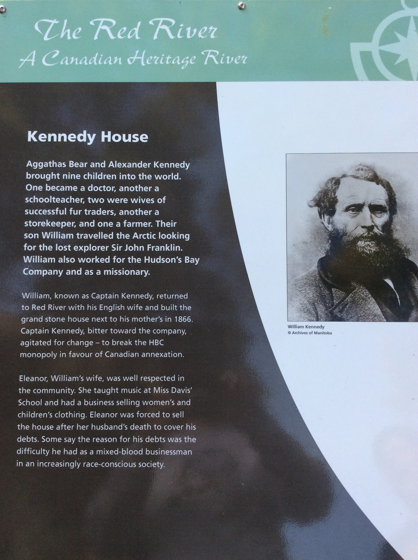
St. Andrews Church
What subject did Eleanor teach at Miss Davis’ school?
What other job did she have?
Why do you suppose Captain Kennedy had so much debt when he died? (discussion topic)

Slide 3
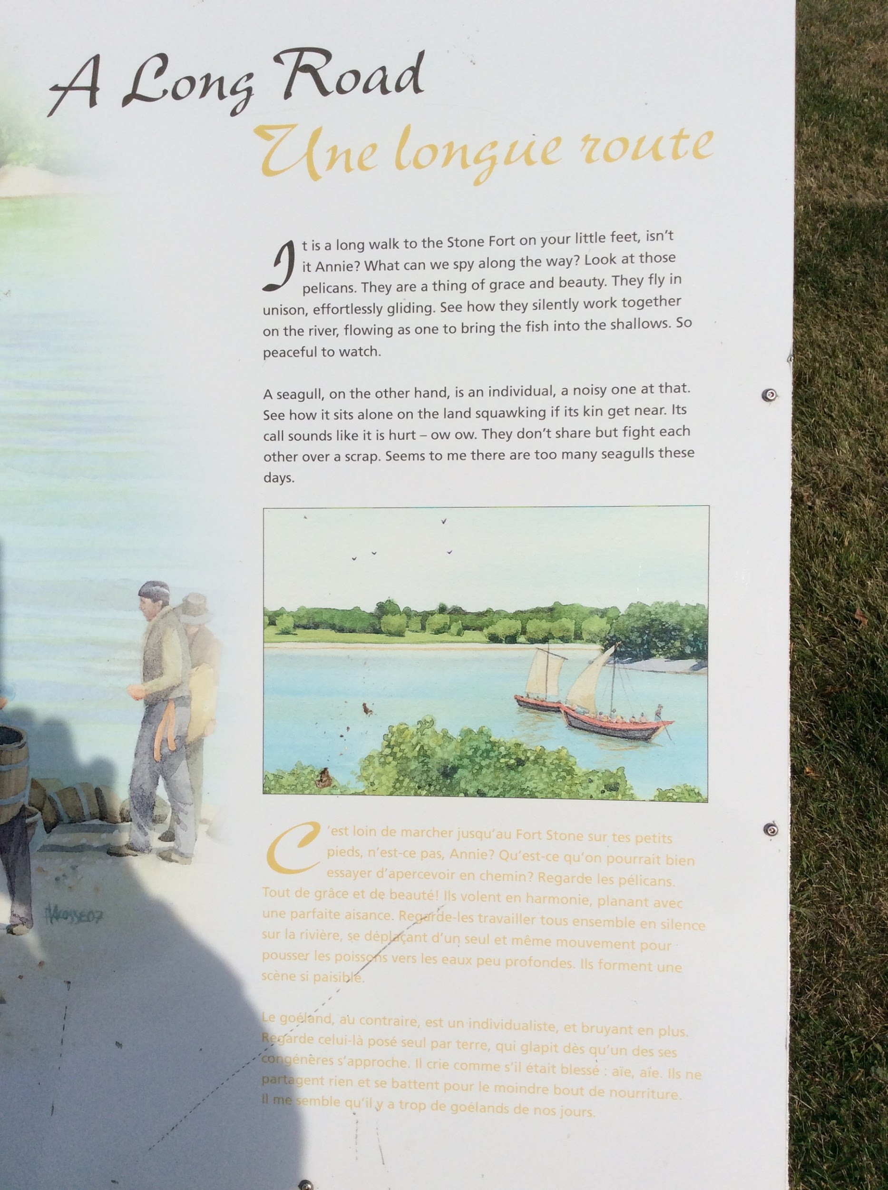
St. Andrews Church
Draw a picture of pelicans on the river.
How are pelicans and seagulls different?
What did James mean when he said, “Seems to me there are too many seagulls these days.” ?

Slide 4
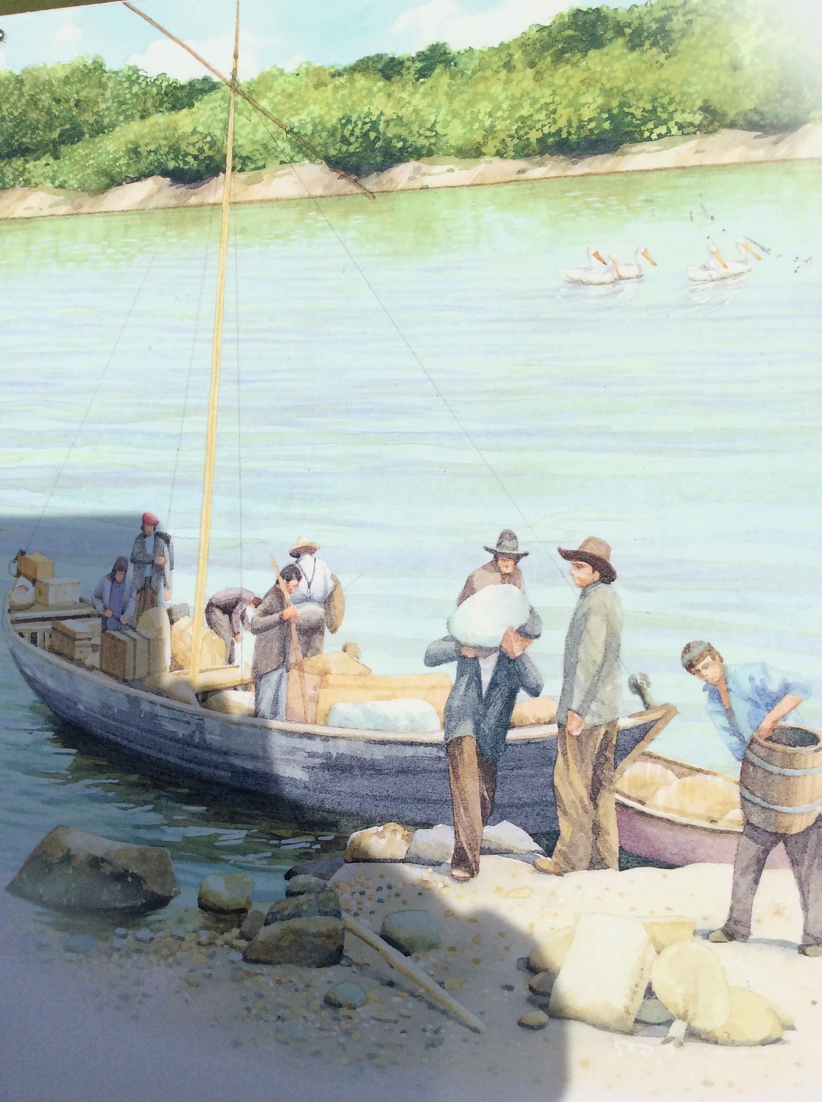
St. Andrews Church
What company do these men work for?
What type of cargo could they be carrying?
Why would they be landing their boat on the shoreline? What obstacle might be in their way?

Slide 5
St. Andrews Church
Why is the St. Andrews Dam an unusual design?
Why was the dam built?
What types of tools did they use to build the dam?

Slide 6
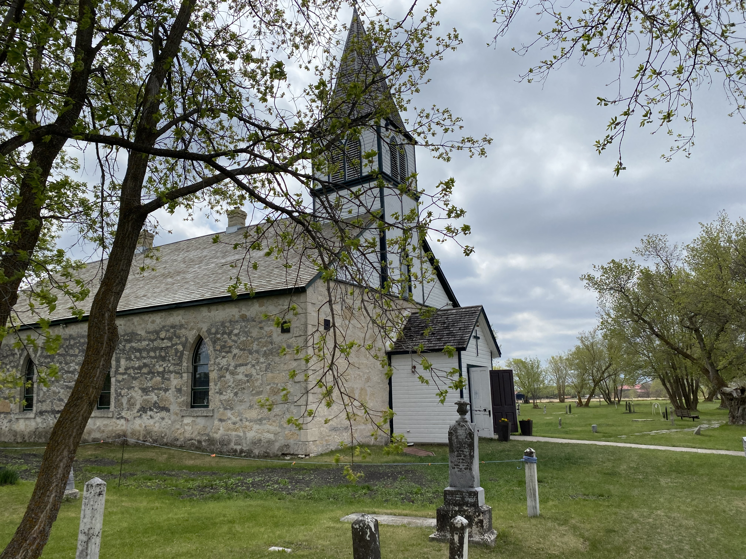
We have now reached the last stop of our tour, St. Peter’s Church in your very own backyard, East Selkirk.
Why do you think this church is an important part of the history of East Selkirk?

