Slide 1
Goals for next meeting
Who invented the birch bark canoe?
How big was a York boat?
How did the steamboat bring about its own demise?

Slide 2
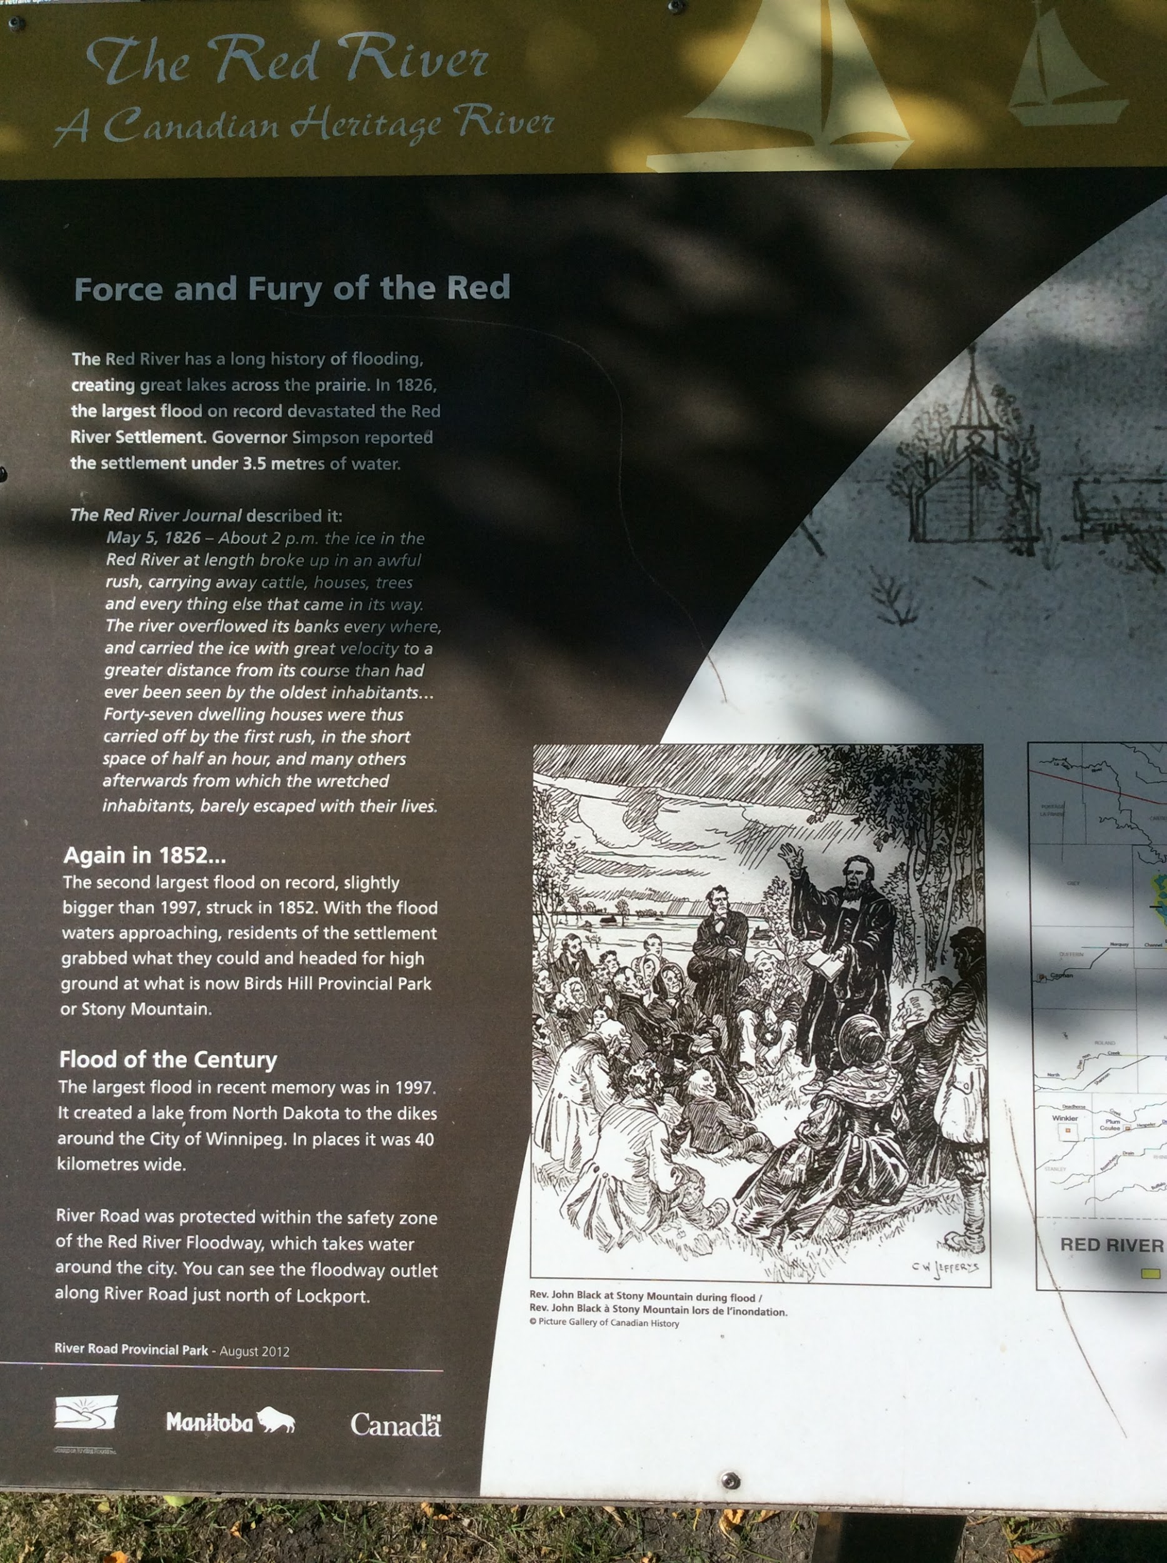
Goals for next meeting
What things got destroyed during the flood of 1826?
In 1852 there was another large flood. Using an atlas find out how far the residents had to travel to reach Bird’s Hill Park from the Red River.
When was the floodway built? Why was it built?

Slide 3
Goals for next meeting
Why were retired Hudson Bay workers given land next to waterways?
If you were to buy an empty river lot that was 25 acres how much would it cost today?

Slide 4
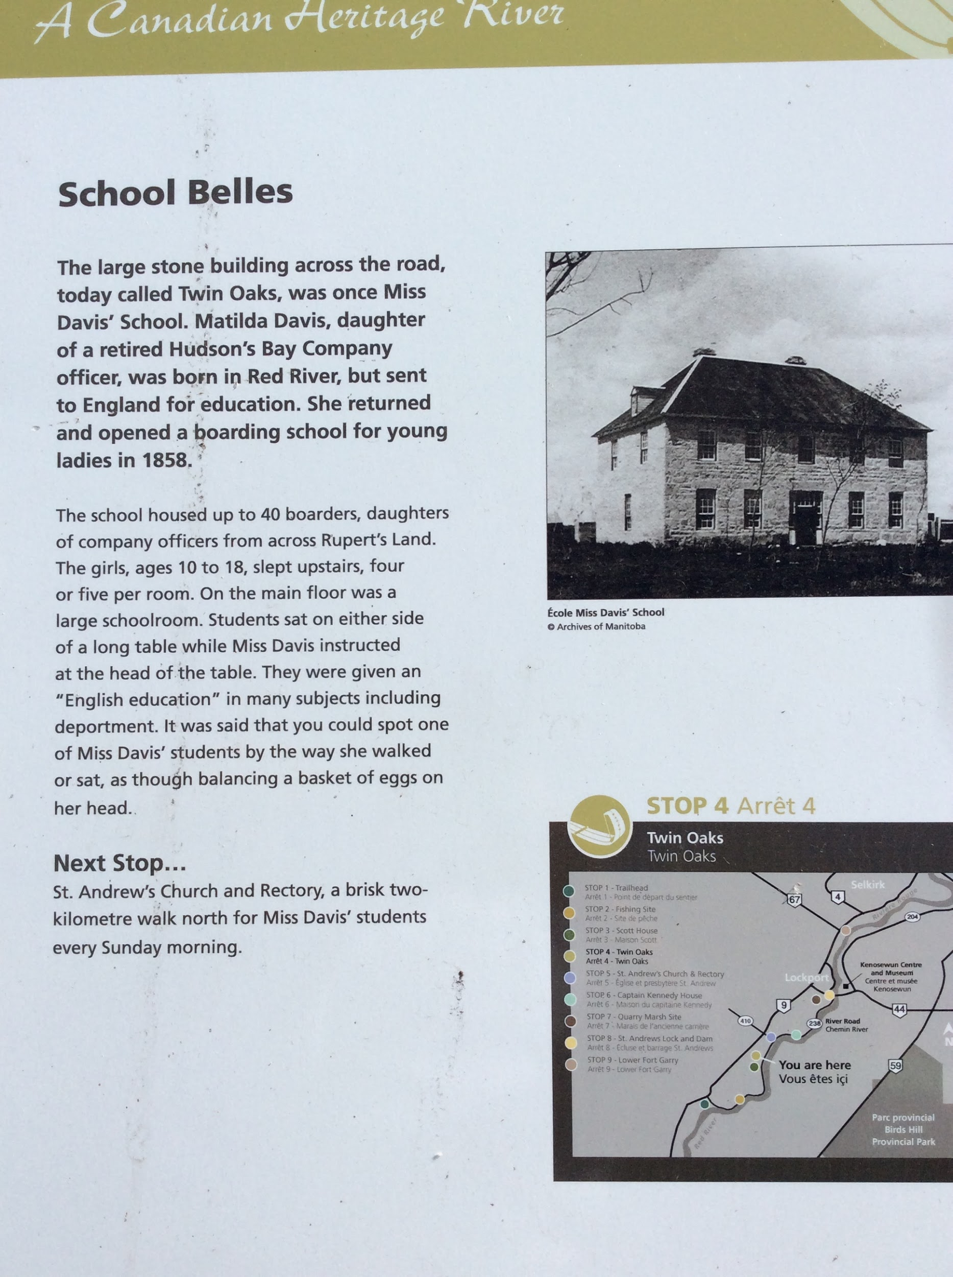
Goals for next meeting
Why was Matilda Davis sent to England for her education?
Imagine you were a young girl living at Miss Davis’ school. Write a letter to your family telling them about the things you were learning.

Slide 5
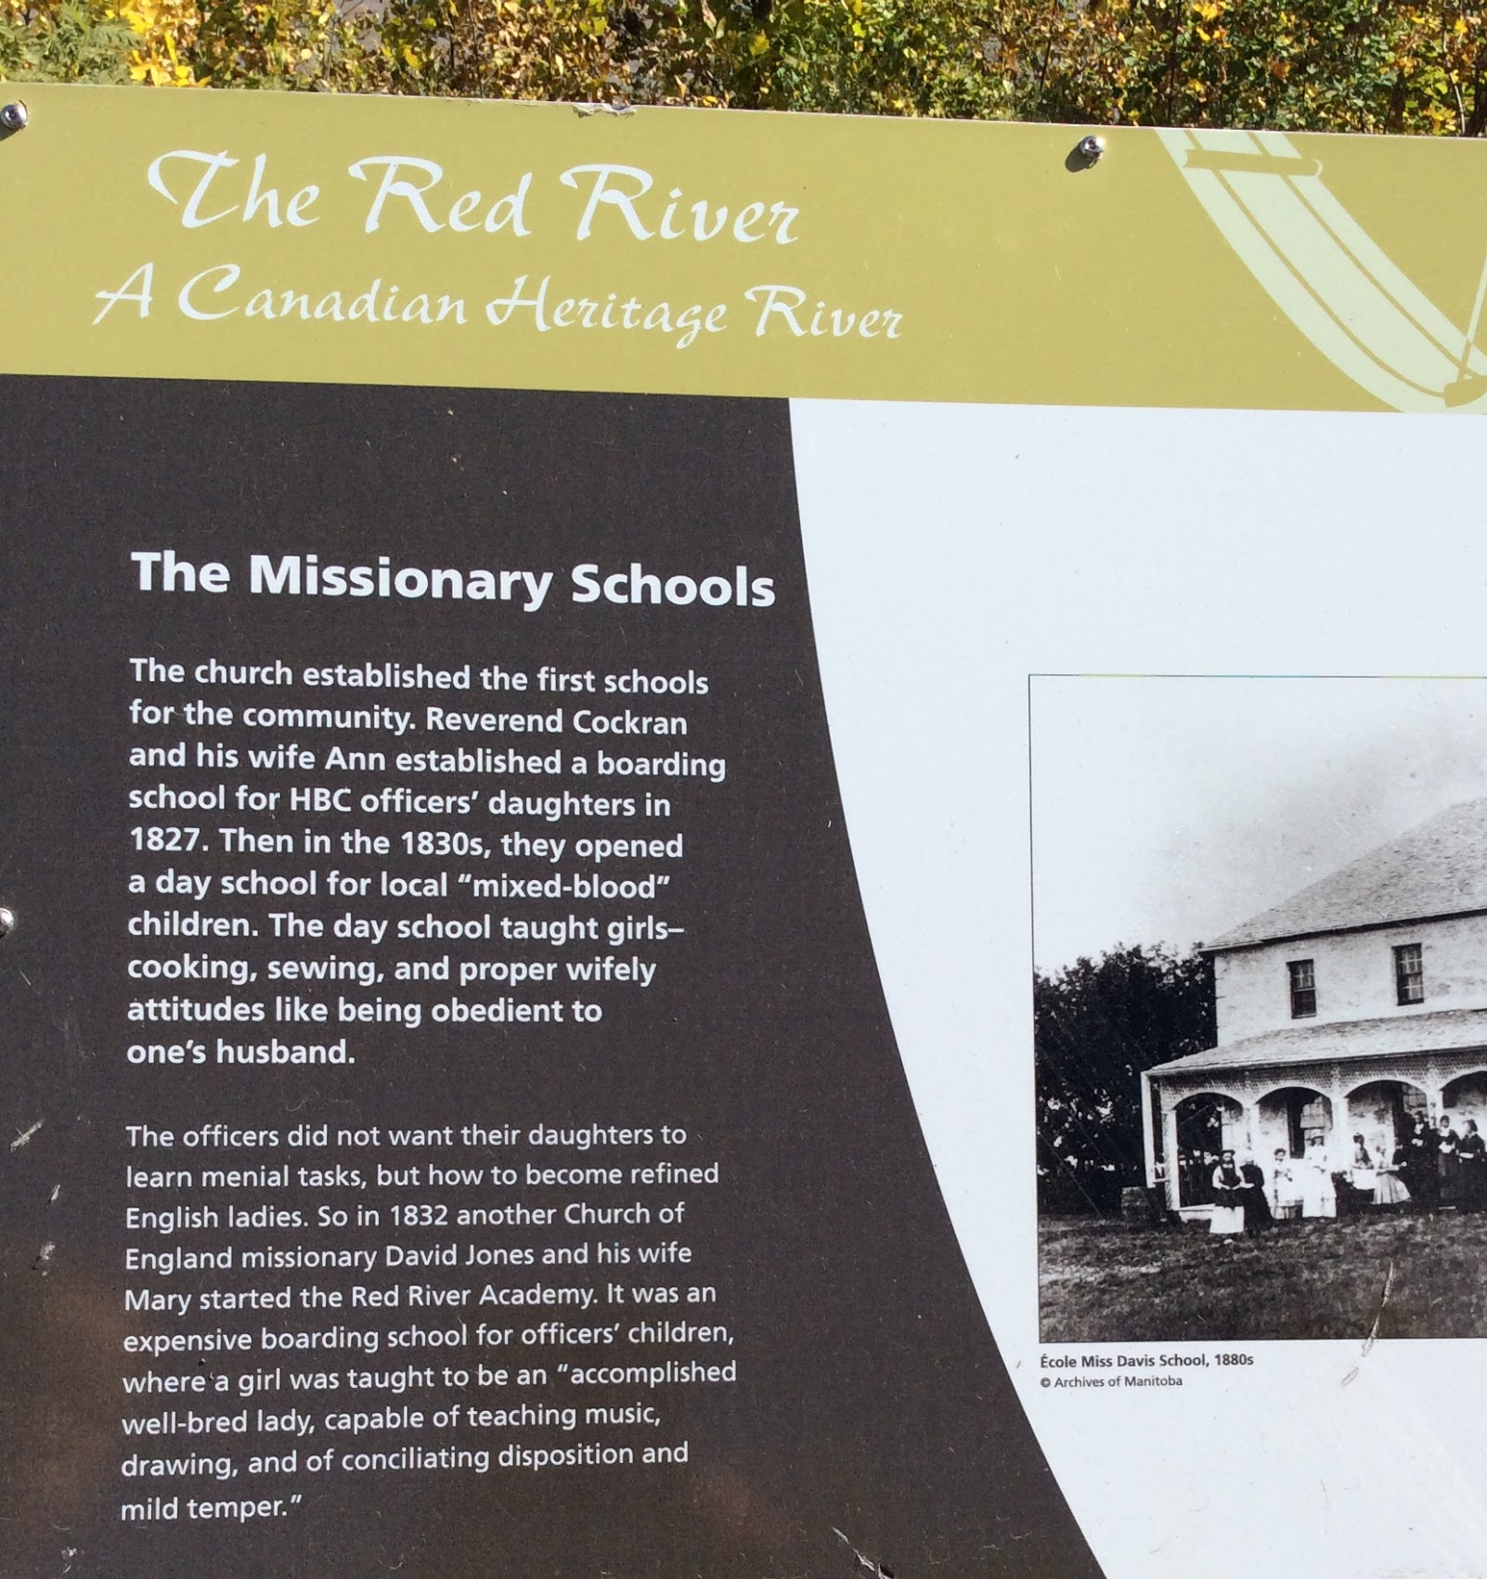
Goals for next meeting
The “mixed blood” day school taught the girls cooking and sewing. What do you think the boys would be taught?
What types of things did they teach girls in the Red River Academy?

Slide 6
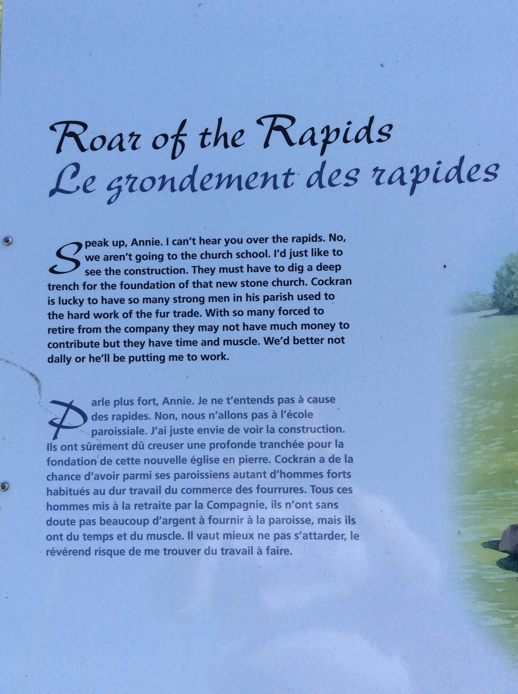
Goals for next meeting
The “mixed blood” day school taught the girls cooking and sewing. What do you think the boys would be taught?
What types of things did they teach girls in the Red River Academy?

Slide 7
St. Andrews Church
What type of structure was the original church?
Why was it called Grand Rapids Church?
What happened to the rapids on the Red River?

Slide 8
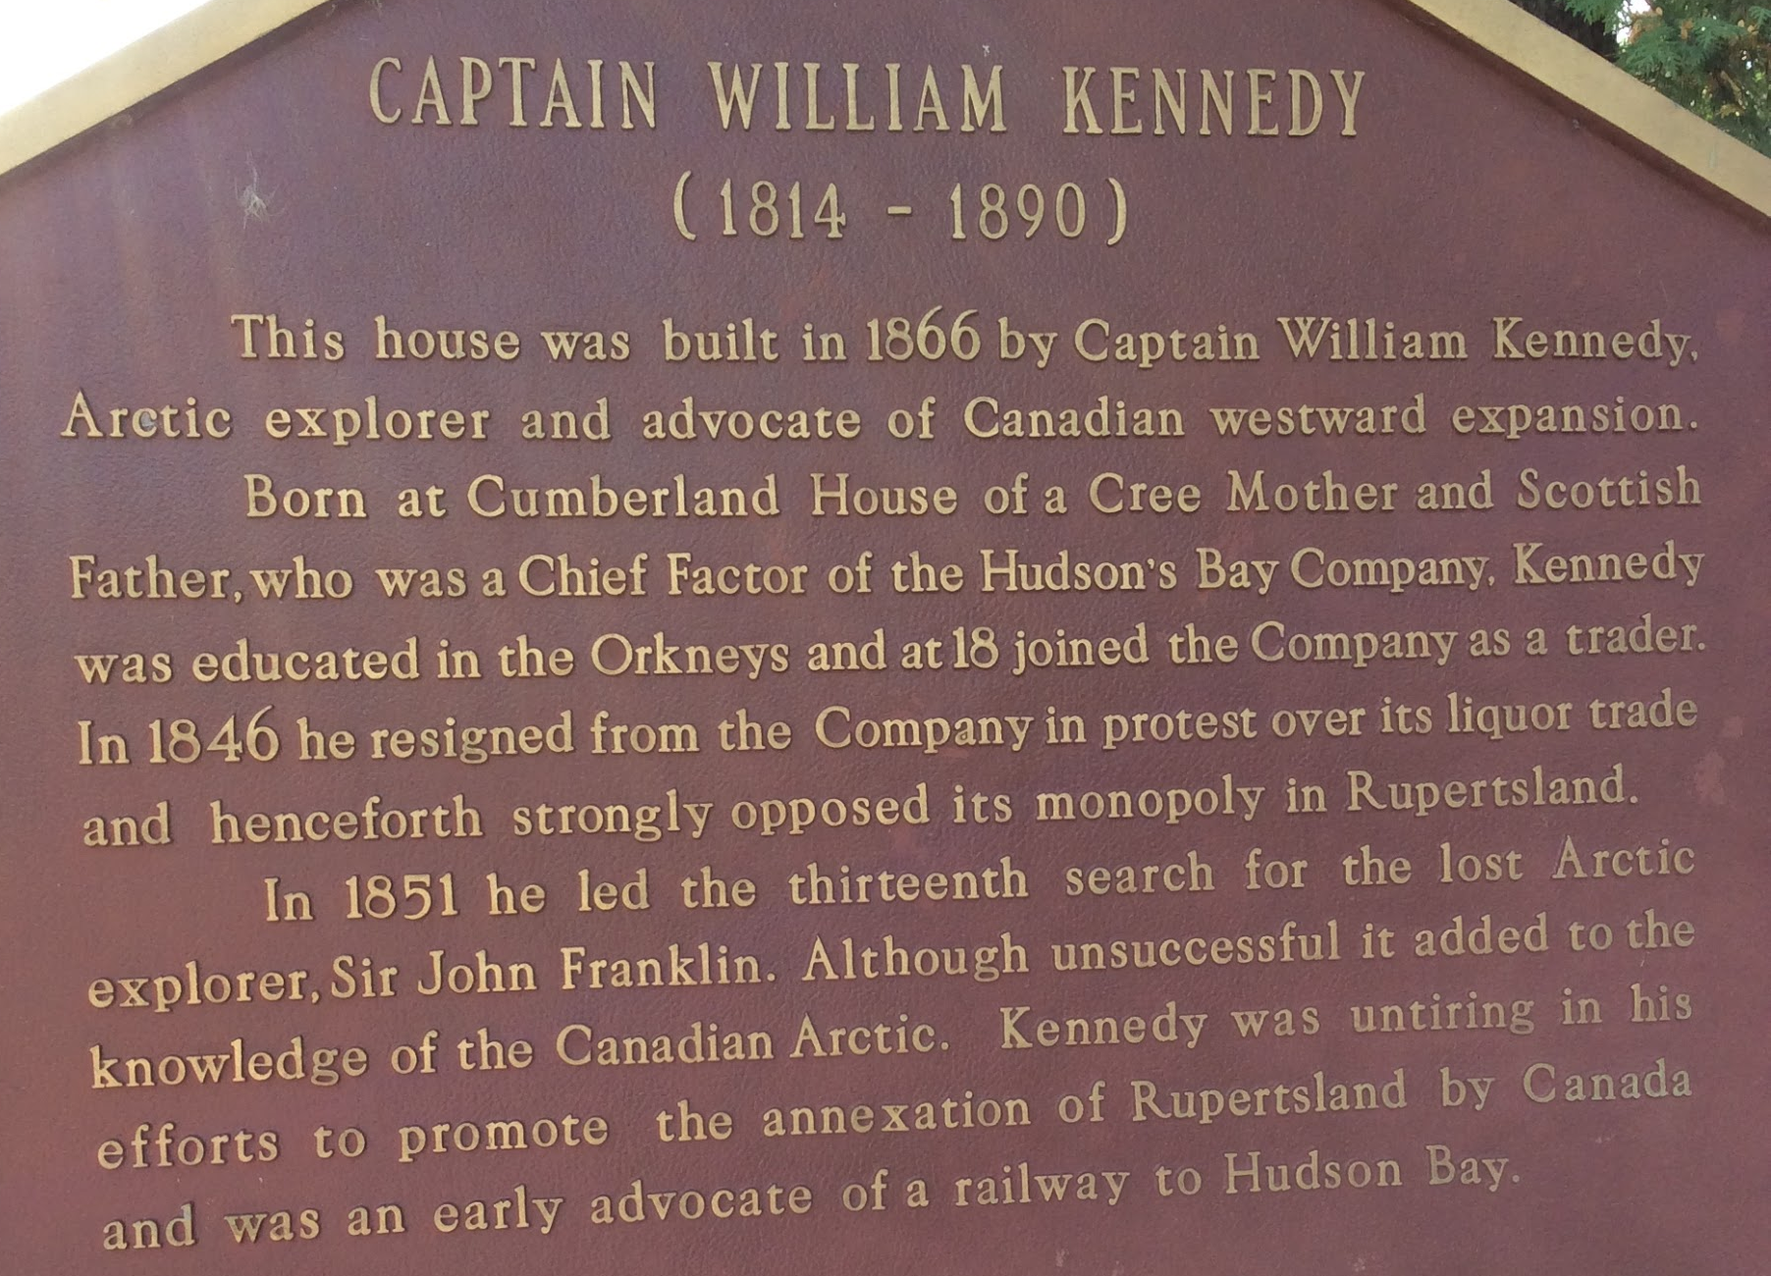
St. Andrews Church
Many Scottish men married Cree women when they came to the Red River settlement. Why do you think that was?
Where was Cumberland House located? (inquiry based research)
Who was Sir John Franklin? (inquiry based research)

