Slide 1
Grade 5 Social Studies: River Road Tour
Please join us for a virtual field trip of the Red River Road, with a very special thank you to Mrs. Procyshyn for her help with this presentation and attendance in the last few years!

Slide 2
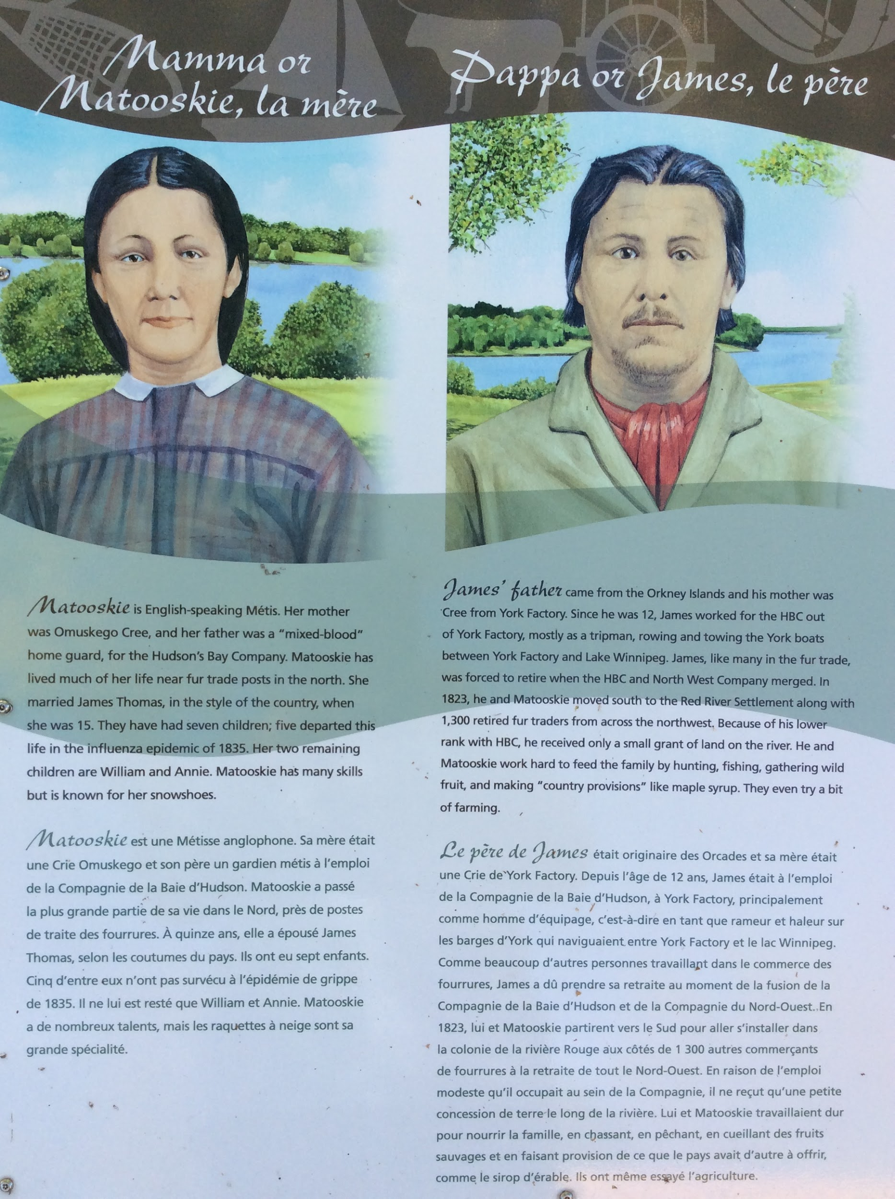
Journal Notes:
Write a brief description of Matooskie and James
What does it mean to be Omuskego Cree? (Research inquiry)
In Canada how many people were affected by the influenza epidemic ?
Where are the Orkney Islands? Draw a map of the country and label it.

Slide 3
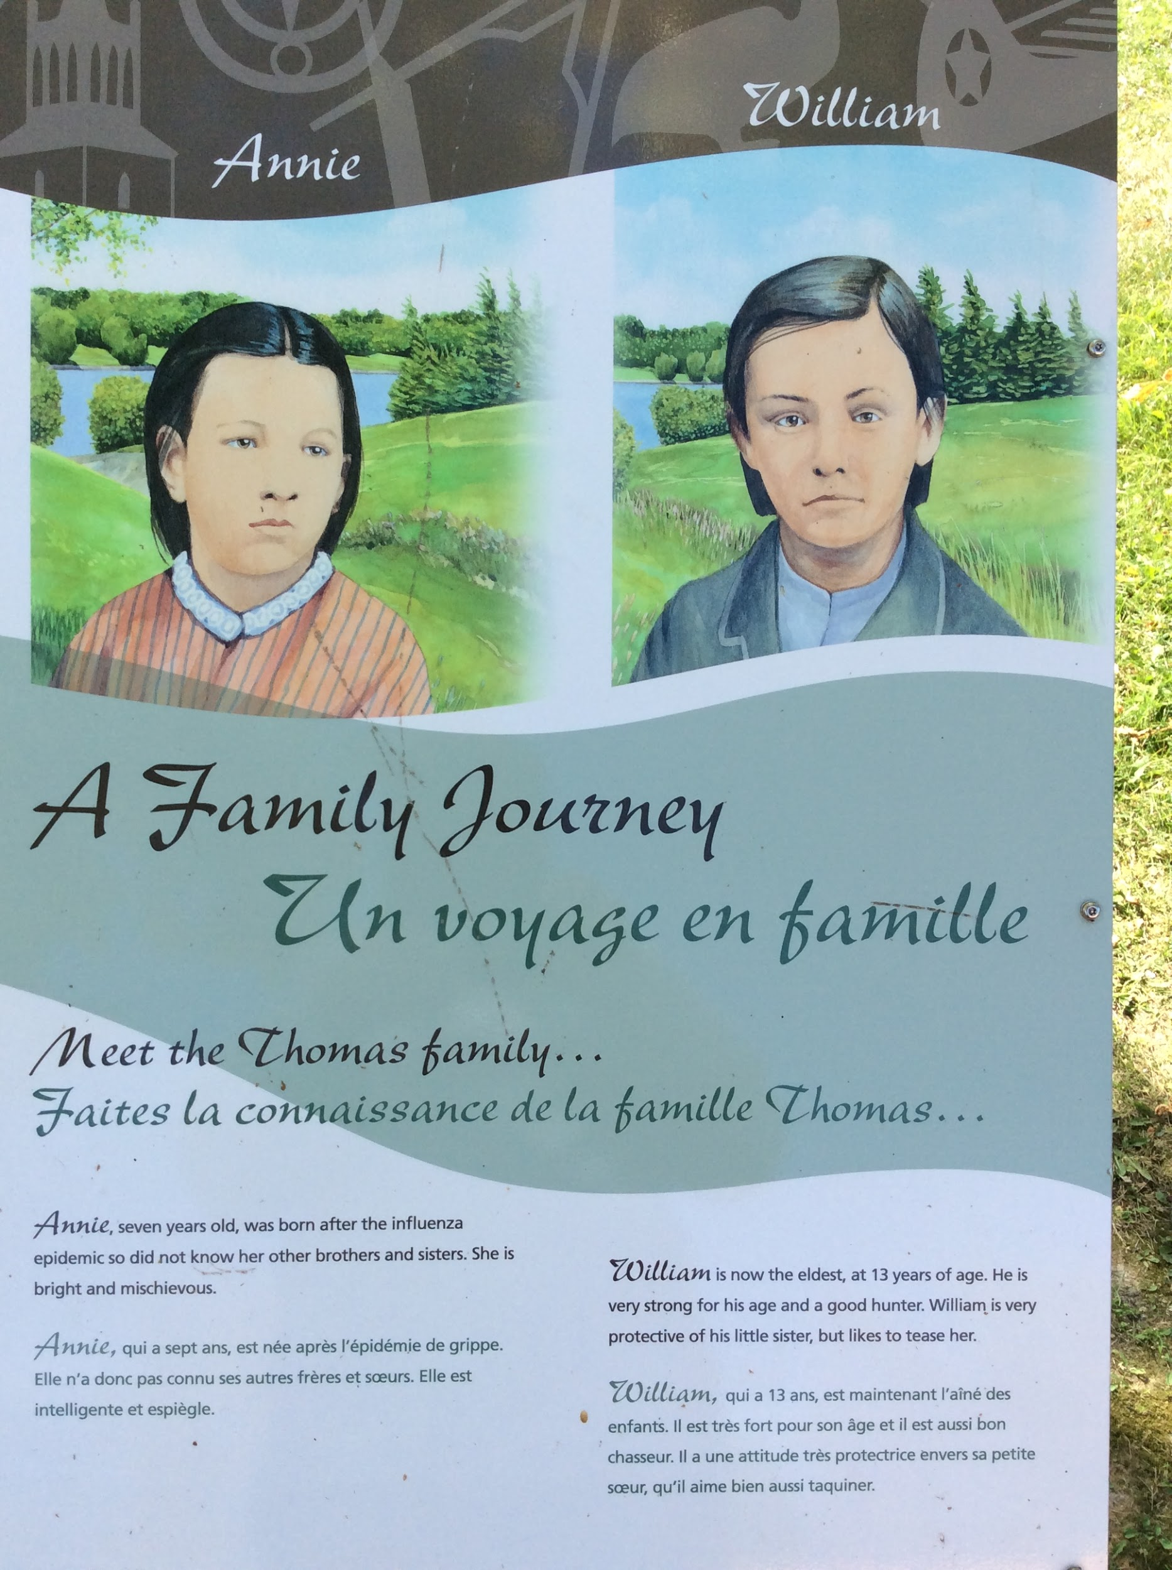
Goals for next meeting
What year do you think Annie was born?
William is a good hunter. What sorts of weapons would he have used?
The story talks about how Annie and William treat each other. How do you interact with your siblings?

Slide 4
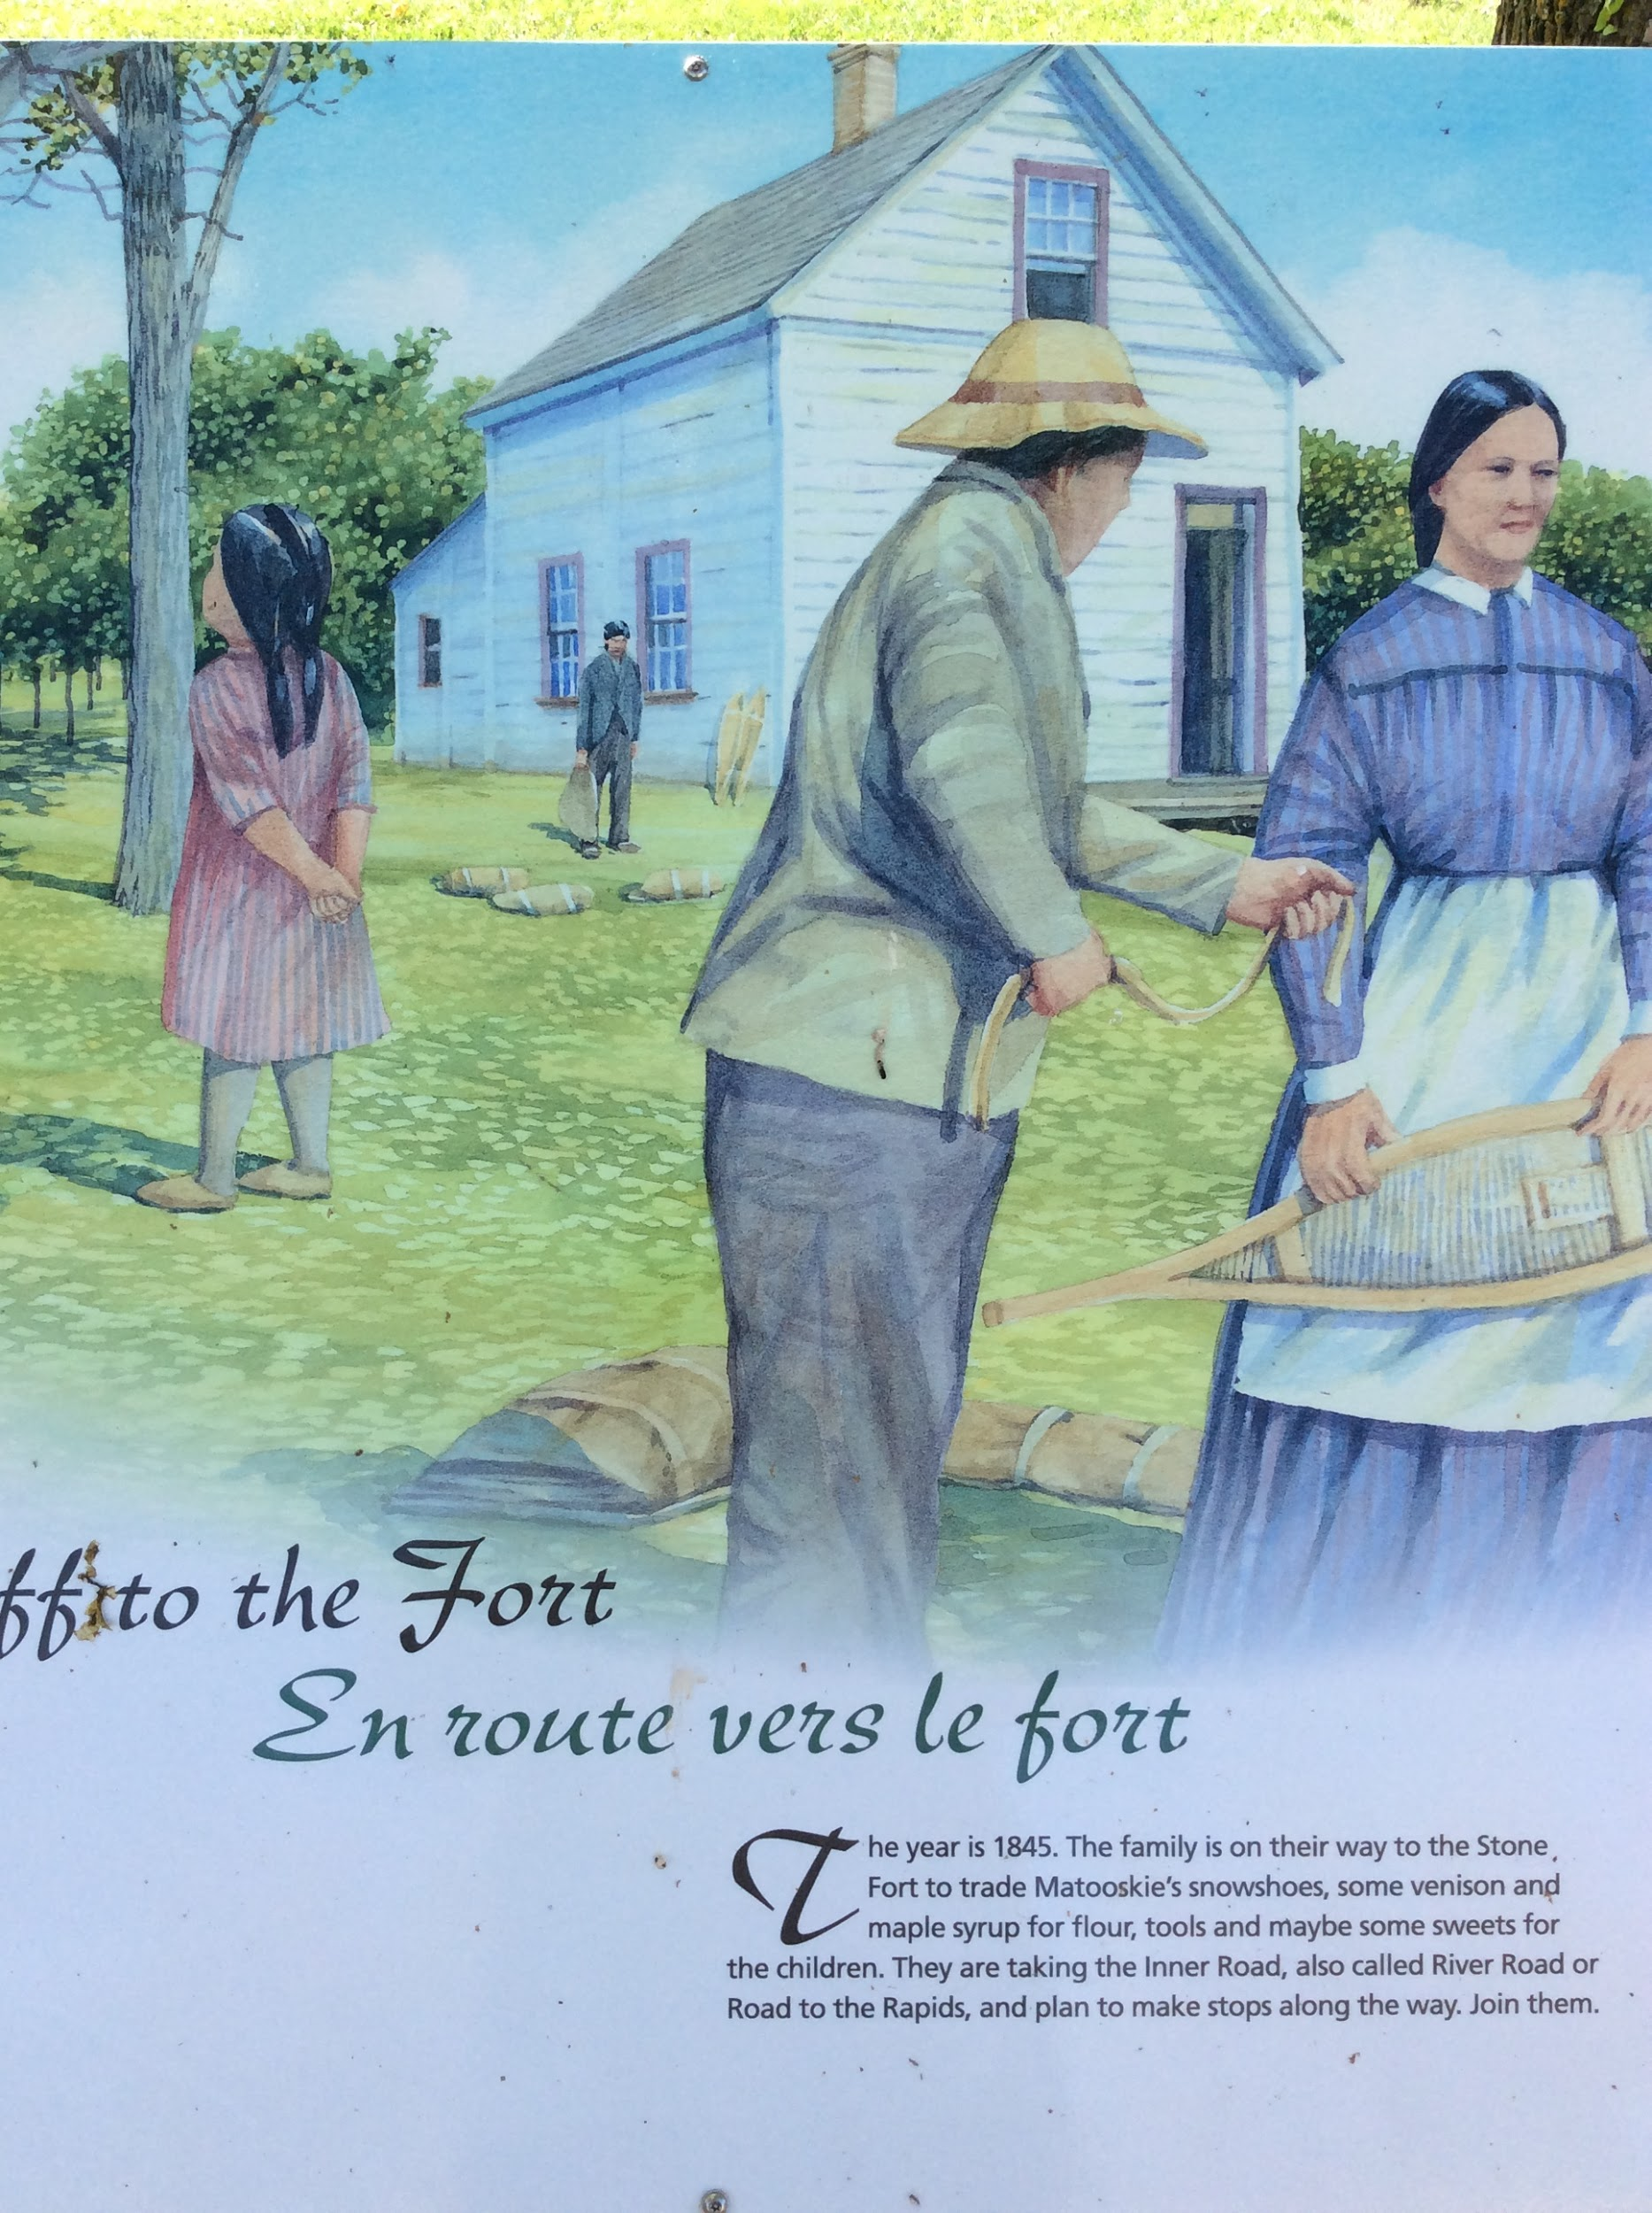
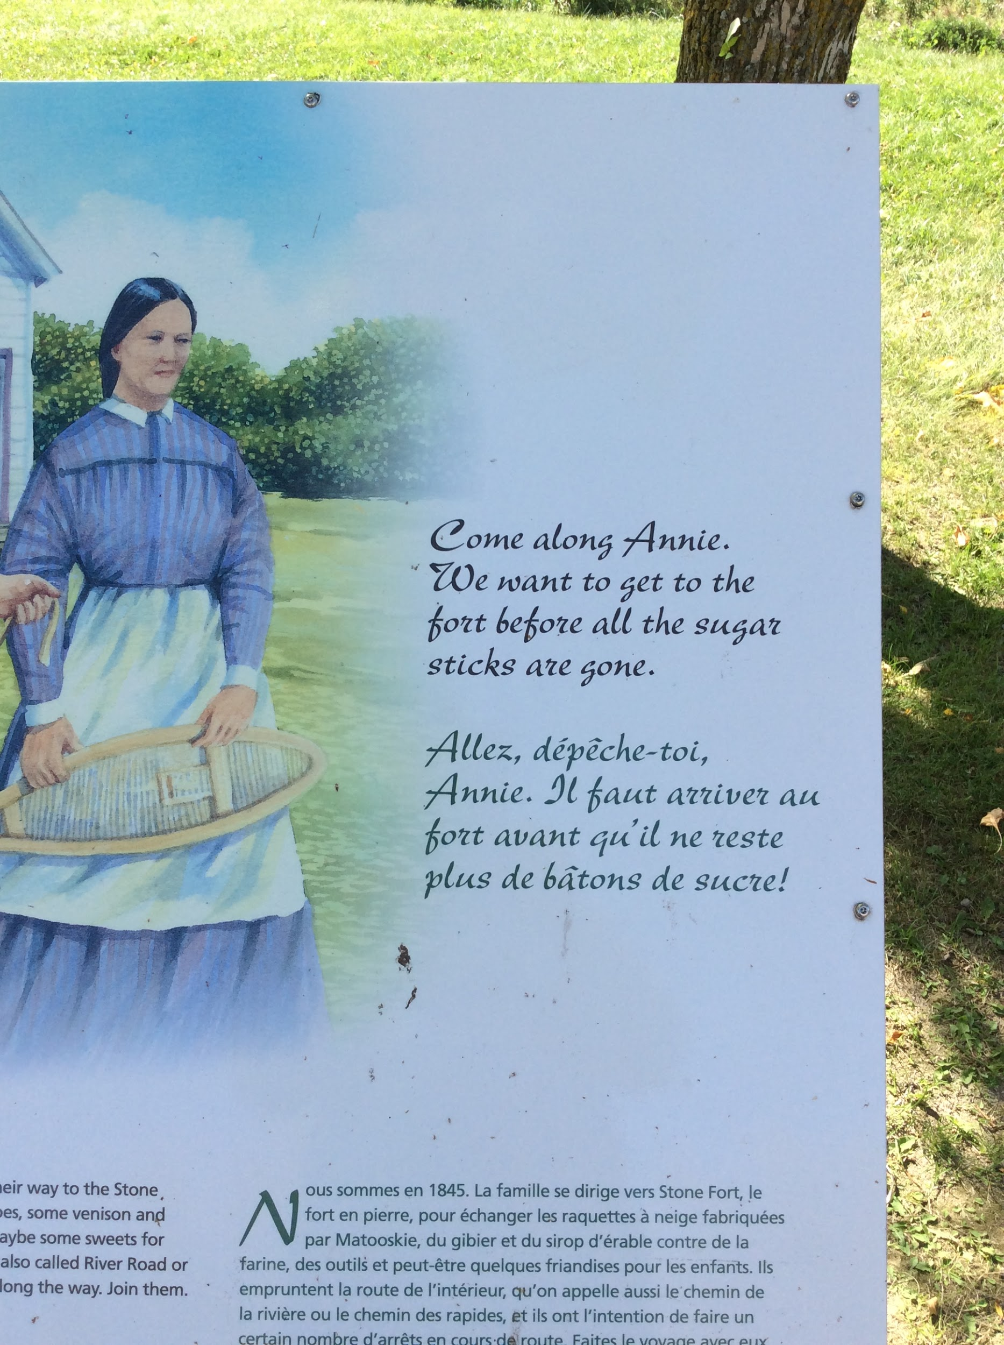
Goals for next meeting
What year do you think Annie was born?
William is a good hunter. What sorts of weapons would he have used?
The story talks about how Annie and William treat each other. How do you interact with your siblings?

Slide 5
Goals for next meeting
Why do you think the fur trade is coming to an end?
What is a missionary and what changes are “afoot”?
It is a long walk to the Stone Fort. How many days do you think it will take?

Slide 6
Goals for next meeting
What does a journalist do for a living?
In what year did Henry Youle Hind go on his expedition?
Why do you suppose River Road was called the Inner Road back then?

Slide 7
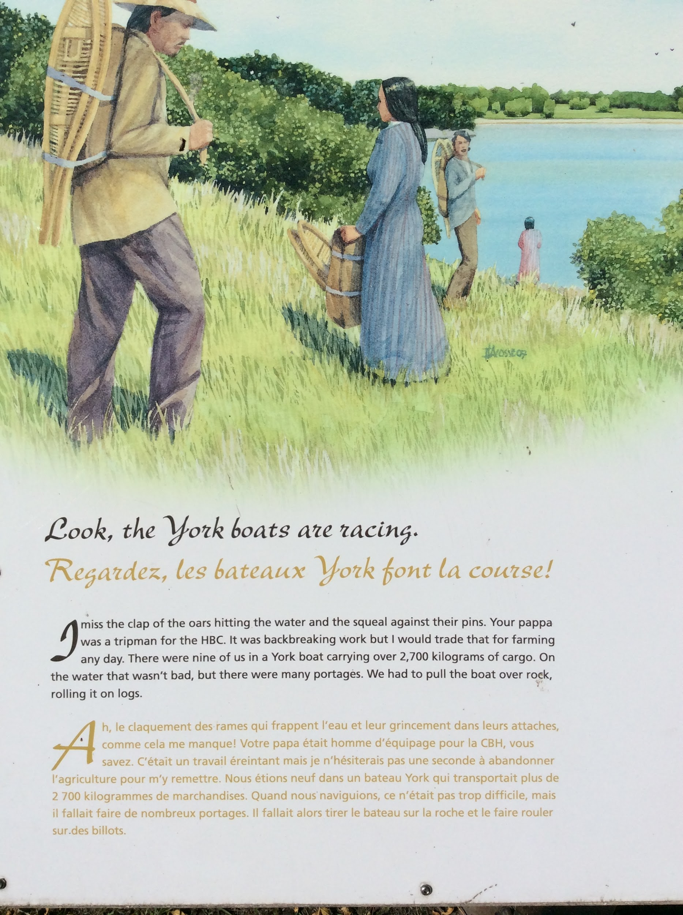
Goals for next meeting
Draw a picture of James and the other Hudson Bay Company tripmen in a york boat.
What might the cargo have been?
What does it mean to portage?

Slide 8
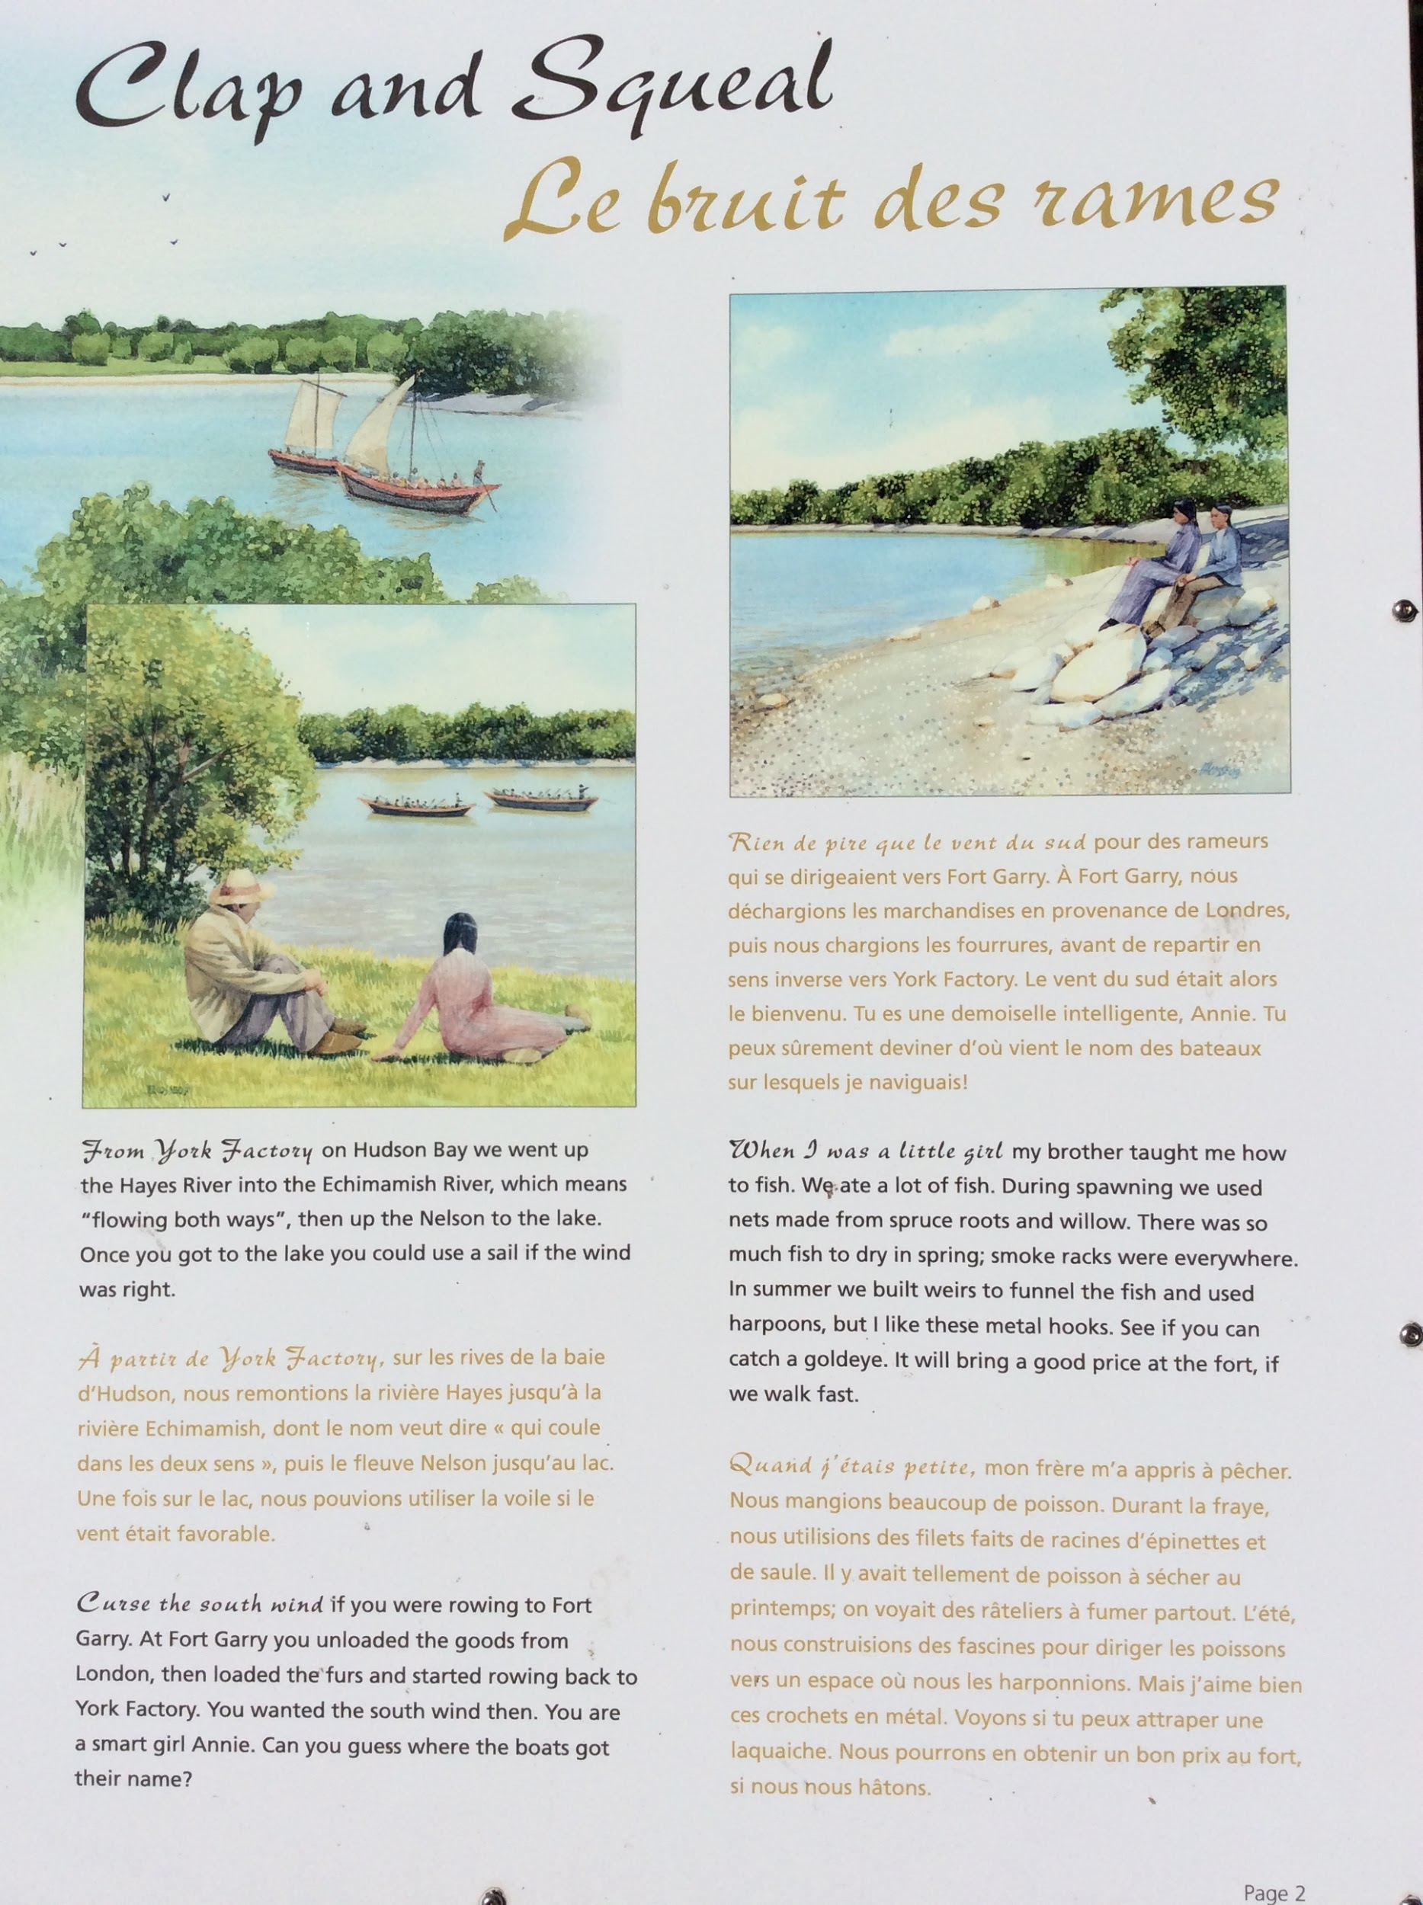
Goals for next meeting
Using an atlas map out the route James would take from York Factory to Fort Garry.
How many kilometers did they travel?
How did the goods get from London, England to York Factory?

Slide 9
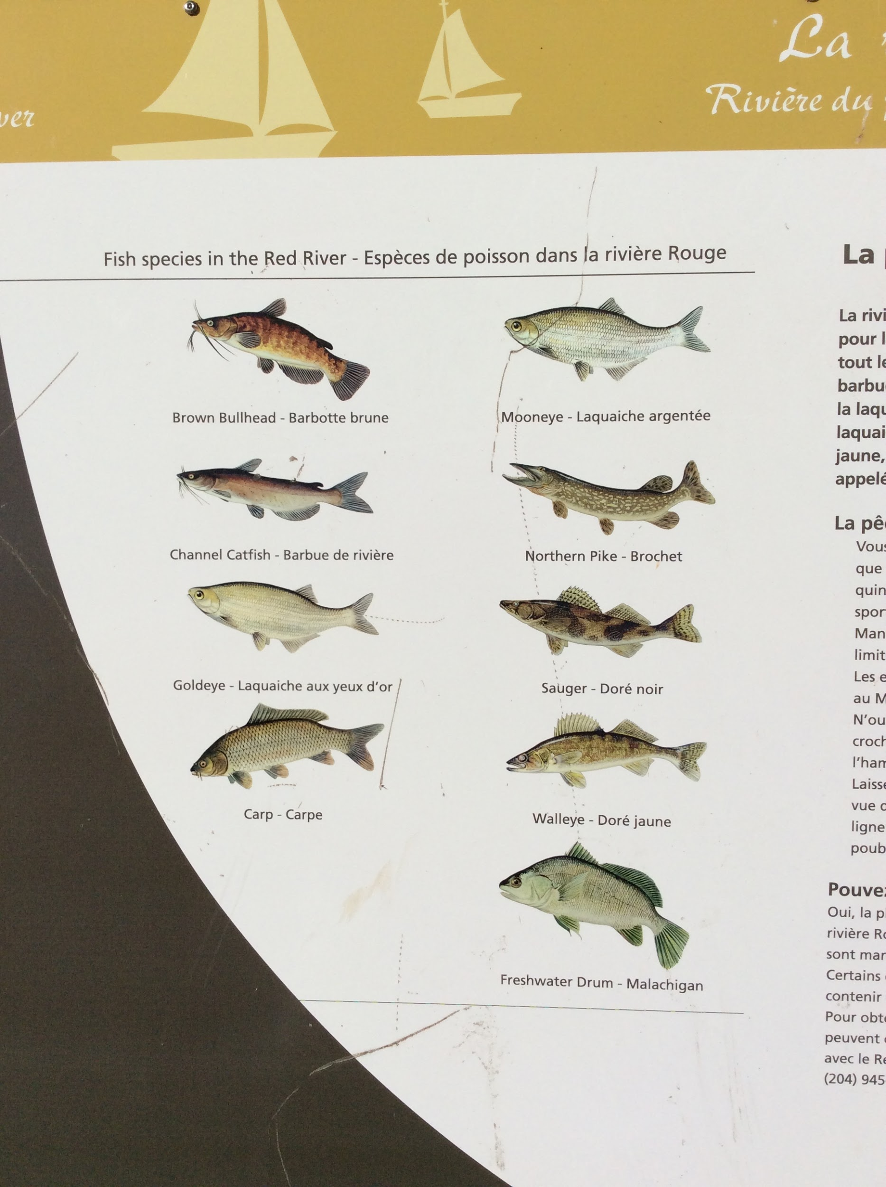
Goals for next meeting
Have you ever caught any of these types of fish on the Red River?
Which ones are good to eat?
How would Matooskie preserve the fish that they caught?

